Slide 1
VARDHAMAN COLLEGE OF ENGINEERING DEPARTMENT OF COMPUTER SCIENCE AND ENGINEERING
Mini Project Review - I
Title: Medicine Overdose Prediction
Team No: 23MPCS-H5
Guide Details
Dr. GOUSE BAIG MOHAMMAD
Associate Professor
S.No | Roll No | Student Name
1. | 23881A05GX | S.SIRI MANVITHA
2. | 23881A05ER | A.RISHI PREETHAM
3. | 23881A05GW | S.VISHWEN

Slide 2
Table of Contents
1. Title
2. Background Research
3. Project Planning (Include Gantt Chart)
4. Literature Survey
5. Objectives
6. Project Milestone Tracker
7. Q&A

Slide 3
Medicine Overdose Prediction
Domain: ML, Medical Data Analysis, Healthcare
Type: Application
Keywords: Medicine Overdose Prediction, Machine Learning, Patient Safety, Drug Interaction Analysis, Clinical Decision Support

Slide 4
BACKGROUND RESEARCH
1.Existing Solutions
EHR-based machine learning models for overdose risk
Clinical decision support (CDS) integrations
Population-level / public-health overdose forecasting
Drug safety / drug-interaction alert systems
Prescription Monitoring Programs (PMPs)
Medication Safety Apps

Slide 5
BACKGROUND RESEARCH
2.Challenges
Data limitations — availability, completeness, generalizability
Focus on opioids / substance abuse — narrow scope
Interpretability, integration, workflow / usability issues
Ethical, fairness, and bias concerns
Limited evidence of clinical impact
Polypharmacy, comorbidities, and non-opioid drugs under-studied

Slide 6
BACKGROUND RESEARCH
3.Motivation behind the proposed work
Need for Comprehensive, Multi-Drug Overdose Prediction
Personalized Healthcare and Better Clinical Decision Support
Preventing Avoidable Hospitalizations
Broader patient safety beyond opioids Context-relevant data and decision support
Proactive prevention and early intervention
Bridging research-to-practice gap
Ethical and equitable medication management

Slide 7
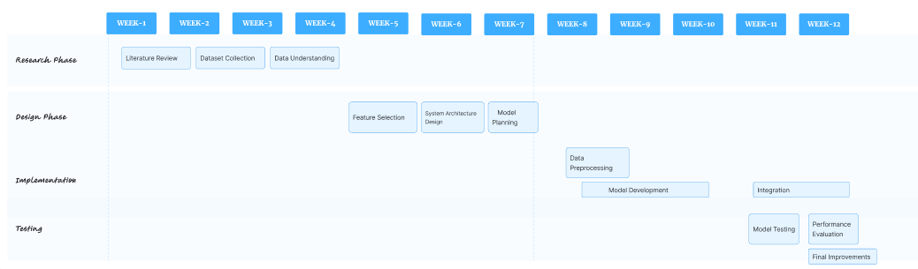
PROJECT PLANNING

Slide 8
LITERATURE SURVEY
Paper Title | Approach/Algorithm | Dataset Used | Key Findings | Gaps Identified
Improving palliative care with deep learning | Uses an 18-layer Deep Neural Network to predict mortality. | Stanford Hospital EHR data of 2million patients. | Model achieved high accuracy in predicting 3–12 month mortality | Mortality is only a proxy & model interpretability is limited.
Doctor AI: Predicting Clinical Events via Recurrent Neural Networks | Uses Random Forest and Logistic Regression to predict opioid overdose risk. | Optum Clinformatics Data Mart (U.S. healthcare claims dataset). | Ensemble ML models accurately identify high-risk opioid overdose patients. | Claims data lacks clinical depth and has limited generalizability.

Slide 9
LITERATURE SURVEY
Paper Title | Approach/Algorithm | Dataset Used | Key Findings | Gaps Identified
Drug and Opioid-Involved Overdose Deaths — United States, 2013–2017 | Uses epidemiological trend analysis with Joinpoint regression. | National Vital Statistics System U.S. mortality data. | Opioidoverdose deaths increased sharply due to synthetic opioids | Death records have incomplete toxicology and reporting gaps.
Deep Learning on Electronic Health Records to Improve Disease Coding Accuracy | Uses deep neural networks for ICD code prediction. | Cerner Health Facts EHR inpatient dataset. | Deep learning outperformed traditional ML in disease coding. | Limited interpretability and lack of real-world validation

Slide 10
OBJECTIVES
To build a system that predicts the chances of medicine overdose using patient data
To build a system that predicts the chances of medicine overdose using patient data
To apply machine learning models & along with RAG,ollama to find patterns that may lead to overdose.
To integrate the system with electronic health records for real-time alerts and safer medical decisions.
To help doctors and pharmacists by giving early warnings about risky prescriptions.

Slide 11
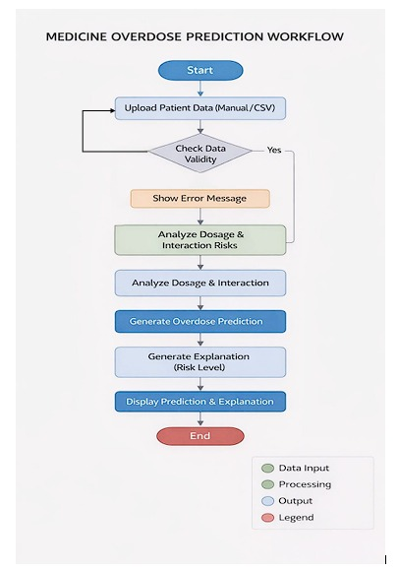
DESIGN PHASE
No

Slide 12
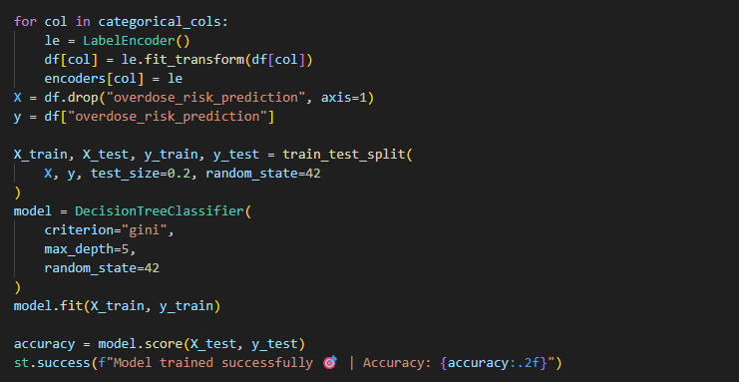
IMPLEMENTATION

